Slide 1

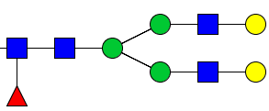

Close mass due to adducts
+ =378.1890
+ NH3 =378.2002
Mass difference=0.0112, if permethylated glycan mass is ~3000 Da, then the difference is ~3.7ppm, which can not be resolved by our MS method.
For example
V.S.
[M+2H]2+
1119.5905
[M+H+NH4]2+
1119.5961

Slide 2
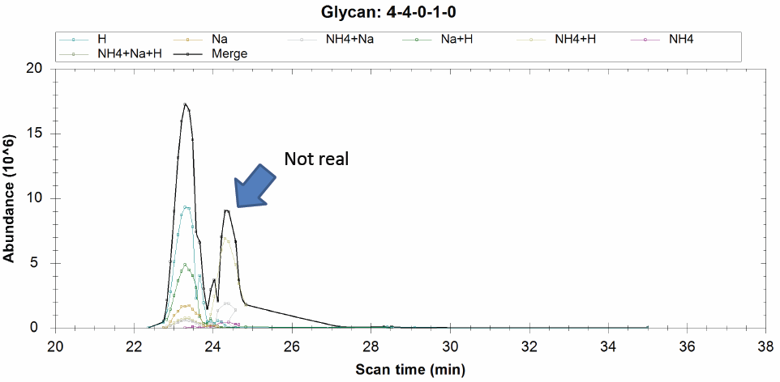

Since this is from glycan: 4-5-1-0-0, this glycan has the retention time as 24.3

Slide 3
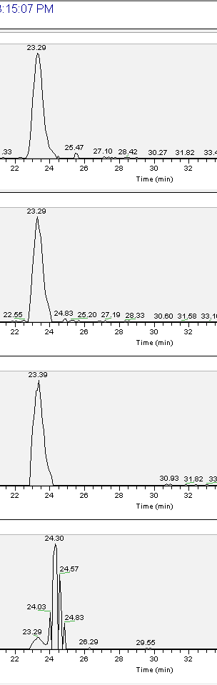
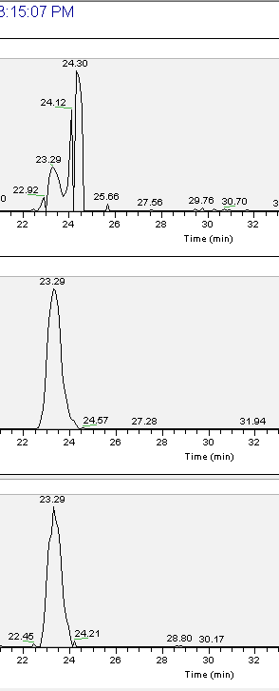
1111.08 H*2 ;
1130.585 NH4*1 ;Na*1 ;
[M+H+Na]2+
1122.072 Na*1 ;H*1 ;
741.056 H*3 ;
1133.063 Na*2 ;
748.3835 Na*1 ;H*2 ;
1119.594 NH4*1 ;H*1 ;
[M+2H]2+

